Slide 1

La certificación ISCC como respuesta a los desafíos de mercado del sector del aceite de palma
Speaker: Dr. Norbert Schmitz

Slide 2
Congreso Palmero C//PAL III
Conferencista: Dr. Norbert Schmitz, Managing Director at ISCC
Norbert Schmitz has studied business administration at the University of Cologne in Germany where he also acquired his PhD.
He has worked several years for a leading European management consultancy before joining Meo Carbon Solutions, a Germany based management consultancy focussing on sustainability.
While working with Meo, Norbert developed in a multi-stakeholder initiative ISCC, International Sustainability and Carbon Certification.
Since 2010, he is Managing Director of ISCC System GmbH.

Slide 3
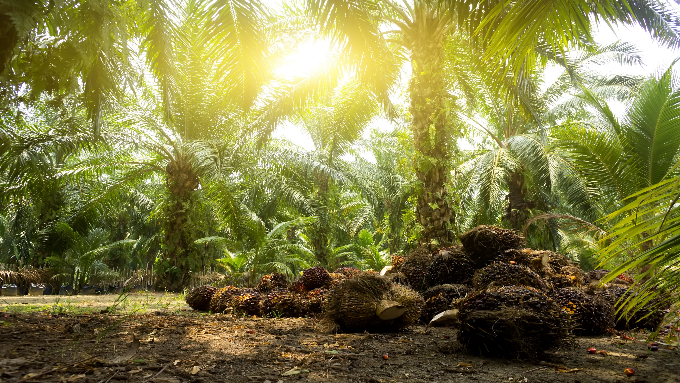
Agenda
01
Current trends and challenges in the palm oil market
02
ISCC as a solution provider for the palm sector
03
Low ILUC certification
04
Conclusions

Slide 4
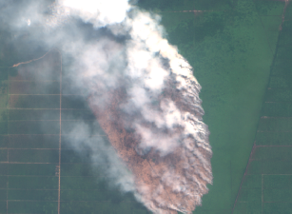
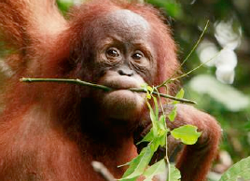
There is rising concern about the environmental impact of palm oil production, resulting in a reputational loss
„Every minute 30 soccer fields are lost to palm plantations.“
Source: Frankfurter Allgemeine Zeitung, 04/2019
„Worlwide over 19 milion hectare are used for palm oil plantations.“
Source: WWF
Deforestation
Ecological
impact
„Palm oil is the leading cause of orangutan extinction.“
Source: Orangutan foundation
„Major human rights issues at Indonesian palm oil companies.“
Source: cnvinternationaal
Social
impact

Slide 5
Palm imports into Germany have decreased significantly
Around 60% of the imported Palm in the EU is used for fuel- and energy production
EU has rated palm as a high-iLUC risk feedstock (Delegated Act 2019/807)
France will ban Palm oil from the energy sector from January 2020 onwards
Over 30% of the imports are used by the food and cosmetics industries
Palm imports to Germany and the EU have lately been decreasing
*Sources: Answer of the Federal Government to a request from the Green Party, 06/19; United States Department for Agriculture

Slide 6
The global production of palm oil is still increasing
Included are the palm oil producing countries Indonesia, Malaysia, Thailand, Colombia, Nigeria and other
*Source: United States Department for Agriculture:

Slide 7
Certification is becoming a prerequisite for market access, also in the food and chemicals sector
„REWE Group has committed itself to the exclusive use of 100 per cent certified palm (kernel) oil.„
„Mondelēz International is committed to sourcing palm oil sustainably and eradicating deforestation and human rights violations in the palm oil supply.“
“Nestlé is committed to using 100% responsibly sourced palm oil by 2020.“
“BASF shifts its Personal Care portfolio and will offer palm-based specialties for the cosmetics industry exclusively as certified sustainable.”
„We’ve created and implemented a No-Deforestation, No Peat, No Exploitation—or No DPE—Policy.“
„Our ambition is to make sustainable palm oil commonplace.“

Slide 8
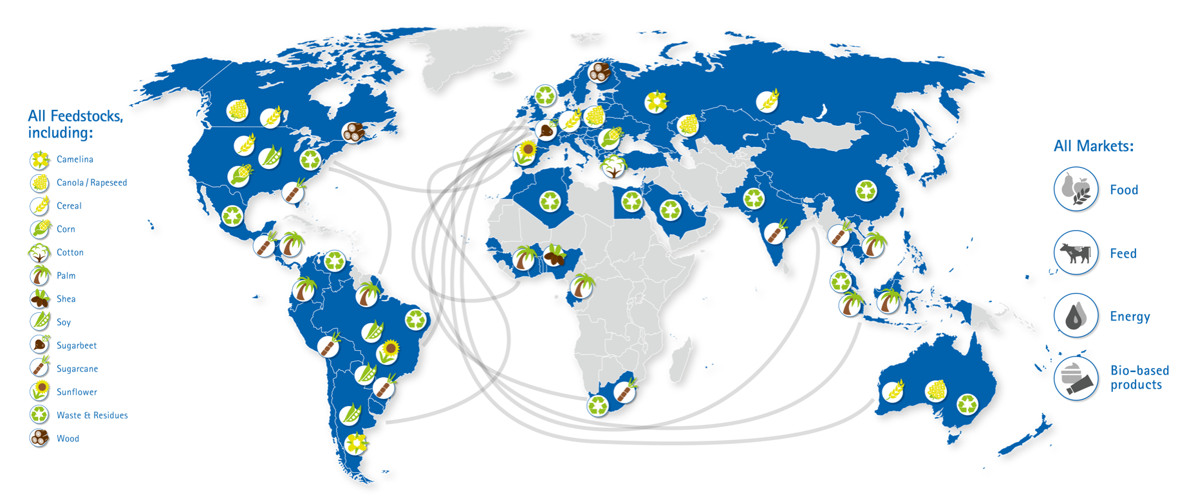
ISCC certification is the solution - ISCC is one of the leading certification schemes applied on a global scale
Over 250 palm oil mills are certified under ISCC.
Currently there are 432 valid ISCC certificates for
companies handling palm.

Slide 9
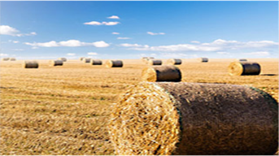
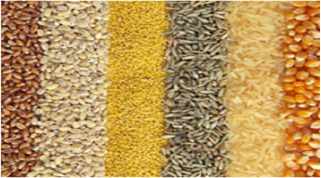

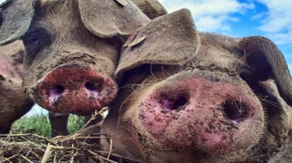

ISCC certification gives access to various markets and certified companies can profit from price premiums
ISCC EU
ISCC PLUS
Biofuels
For markets inside the EU
Energy +
Biofuels
markets
outside
the EU
Food
Feed
Industrial appli-
cations

Slide 10















ISCC is recognized by different Governments, important voluntary initiatives of brand owners and individual companies
Energy
Industrial Applications
Food
Feed
Examples
Renewable Energy Directive (RED) and Fuel Quality Directive (FQD) of the European Union
Sustainable Agriculture Initiative (SAI) Platform
ISCC in line with FEFAC Soy Sourcing Guidelines
Der Blaue Engel
Textile Exchange’s “2025 Sustainable Cotton Challenge”
Coca Cola’s Sustainable Agriculture Guiding Principles
Soy Network Switzerland
Sustainability requirements biofuels
Sustainable supply of raw materials for the industrial use of biomass (INRO)
Soy sourcing supply chains of Mars petcare
Liquid Fuel Supply Regulation of Queensland
Retailers’ Soy Group (RSG) requirements for responsible soy of the Consumer Goods Forum
Soy sourcing supply chains of ADM
Participation in CORSIA for sustainable alternative jet fuels
Green Deal, sustainability criteria for biobased polymer products
Unilever Sustainable Agricultural code
Others
Responsible sourcing practices in areas that are exposed to high risk of deforestation
Recognized by AIREG (Aviation for renewable energy in Germany)
Diageo’s Sustainable Agricultural Sourcing Requirements

Slide 11
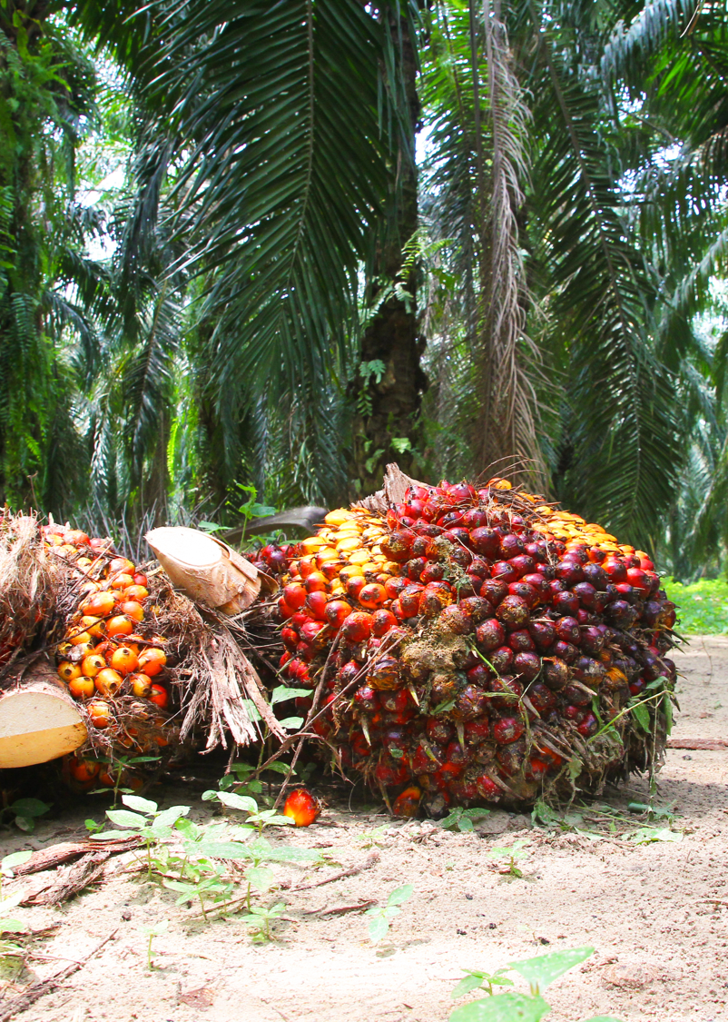

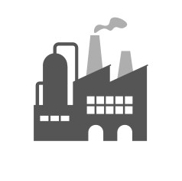


ISCC provides solutions for sustainable palm with fully traceable supply chains
Farm/Plantation/ Point of Origin
Farm/Plantation/ Point of Origin
First Gathering Point / Collecting Point
Processing Unit
Warehouse
Market
Farm/Plantation/ Point of Origin

Slide 12
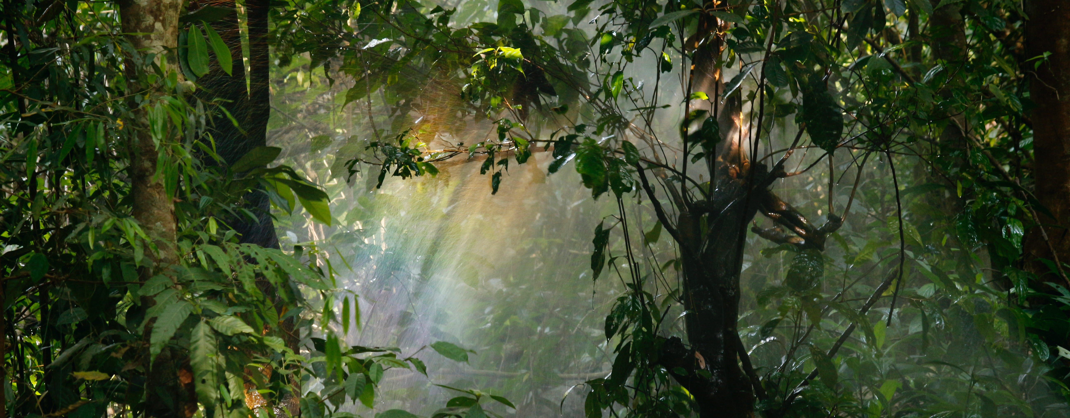
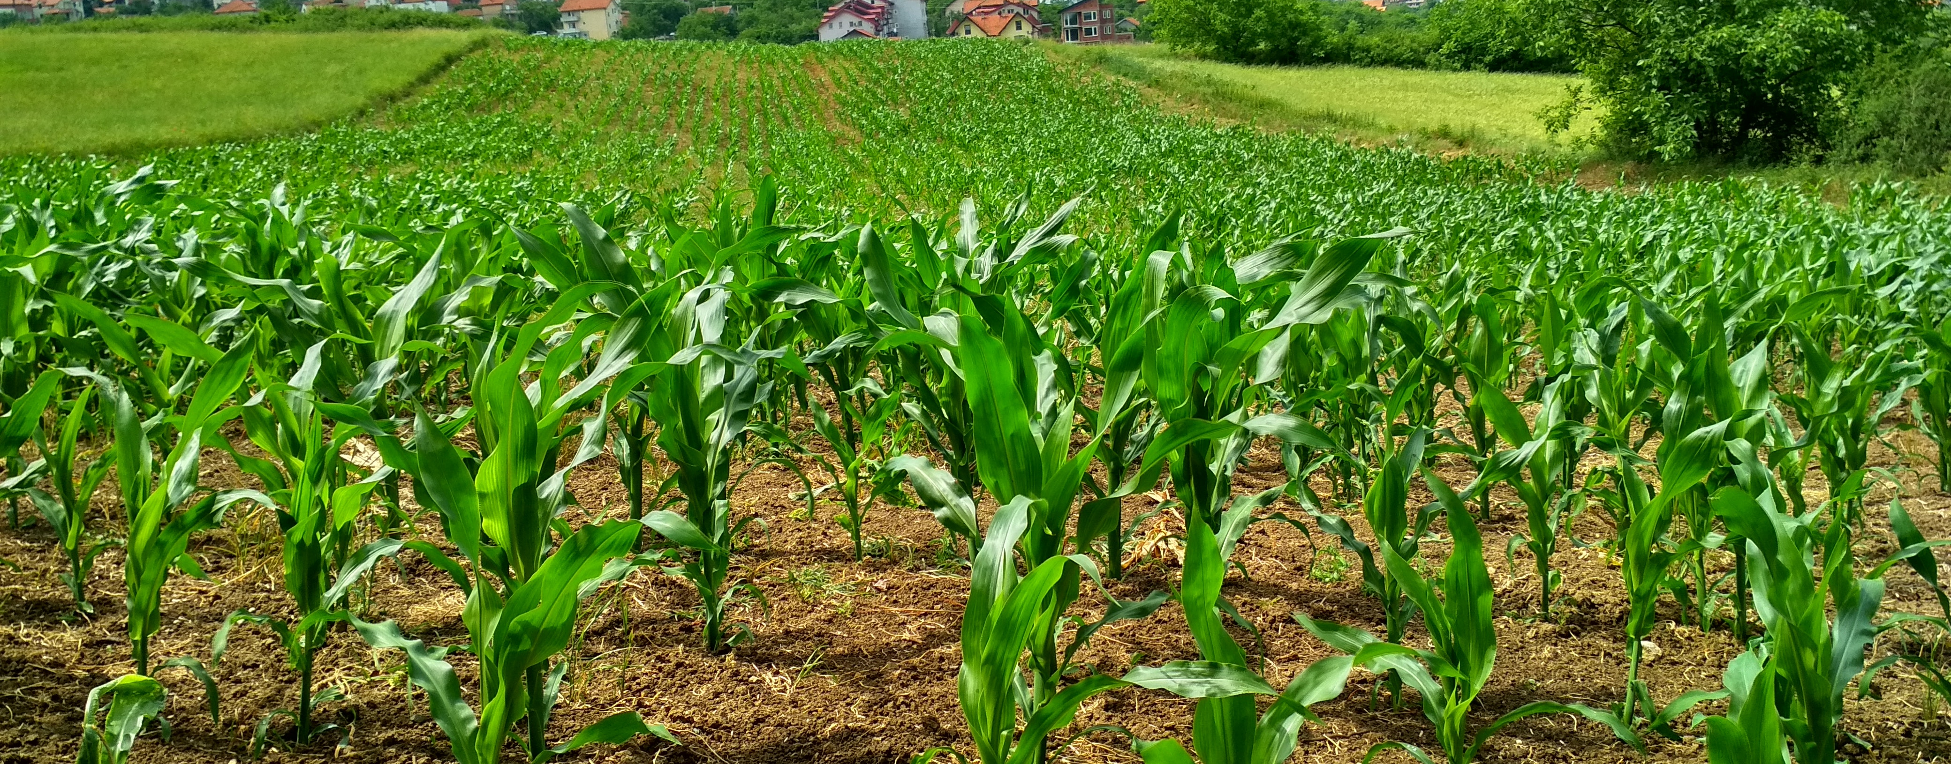
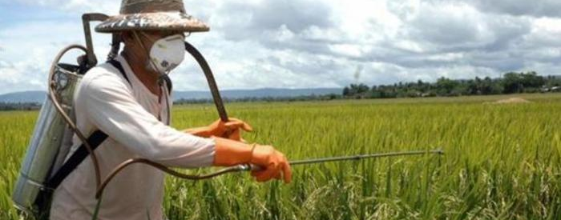
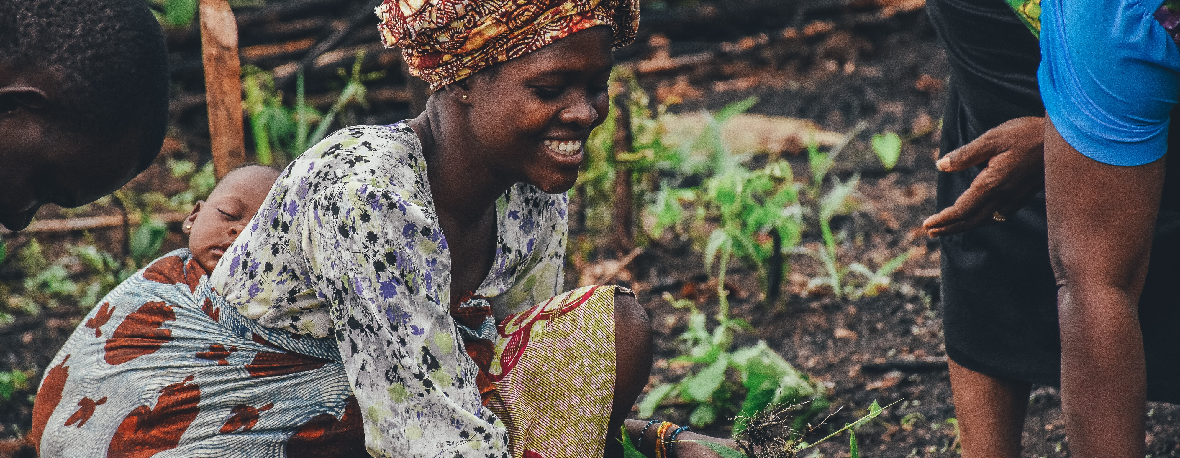
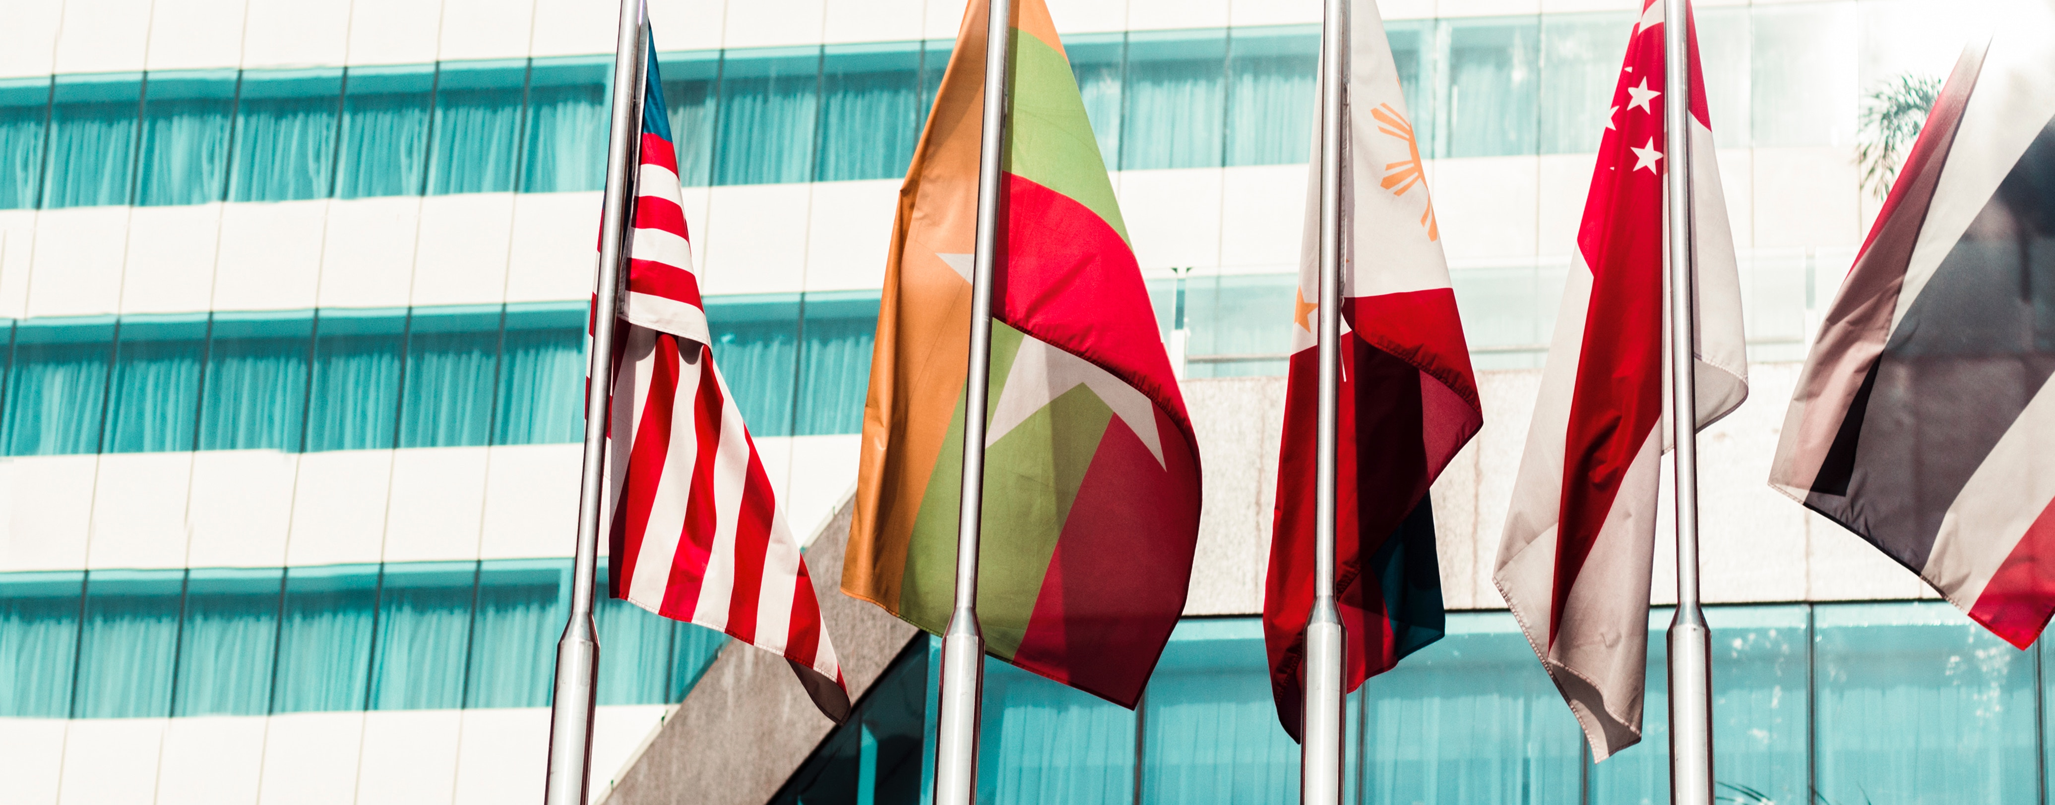
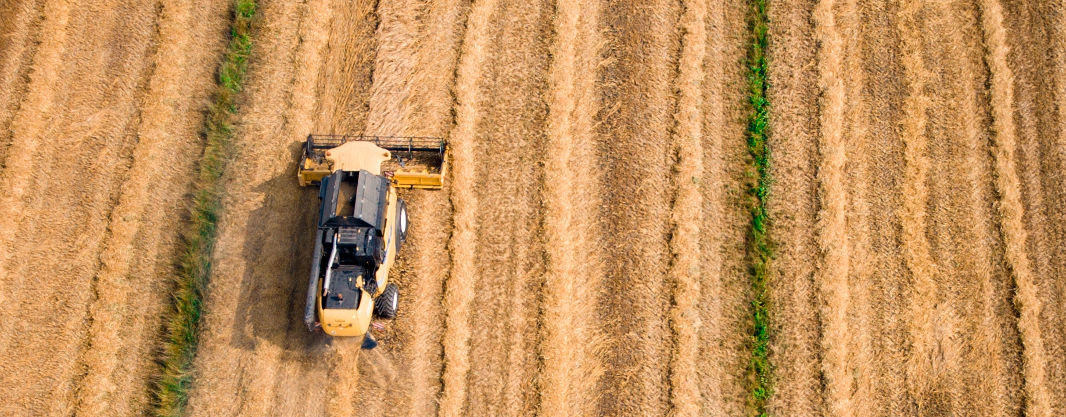
ISCC certifies deforestation-free supply chains and satisfies the rising demand for sustainable products
Principle 1: Protection of biodiverse and carbon rich areas
Principle 2: Good Agricultural Practice
Principle 3: Safe Working Conditions
Principle 4: Compliance with Human, Labour and Land rights
Principle 5: Compliance with Laws and International Treaties
Principle 6: Good Management Practices and Continuous Improvement

Slide 13
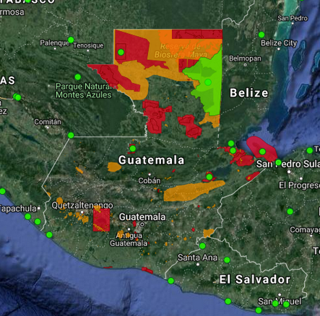
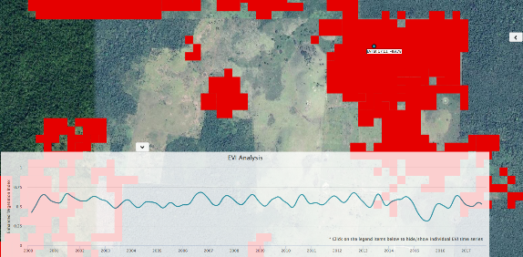
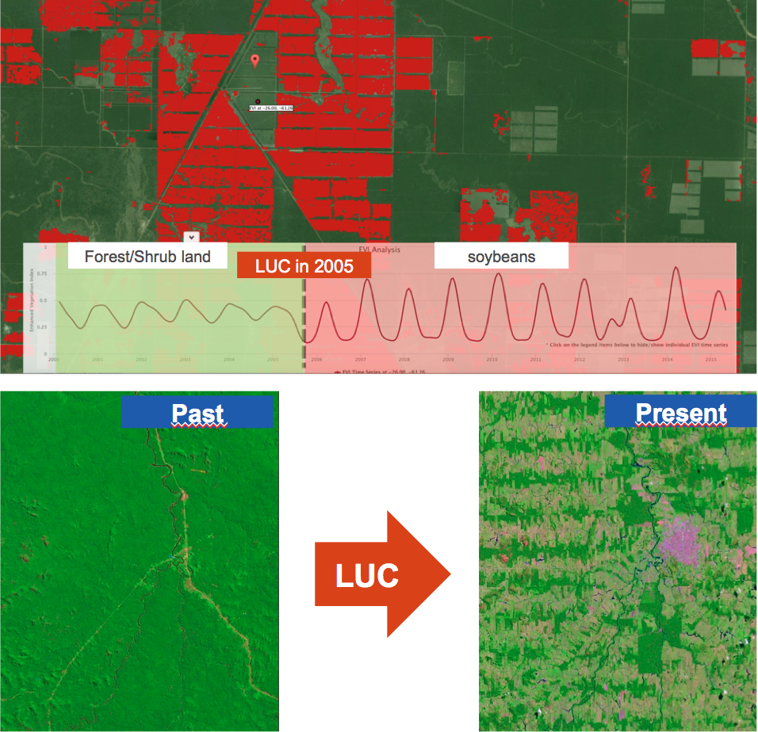
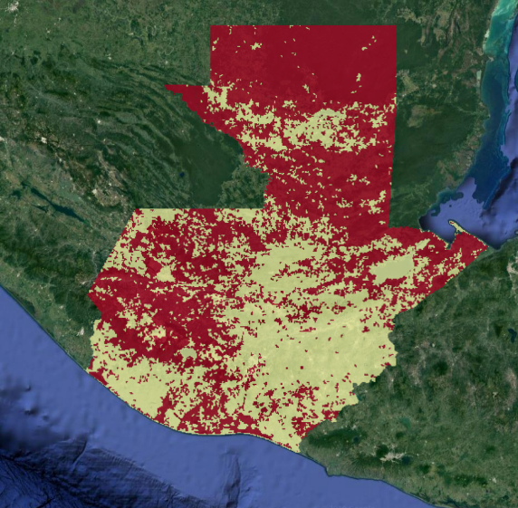
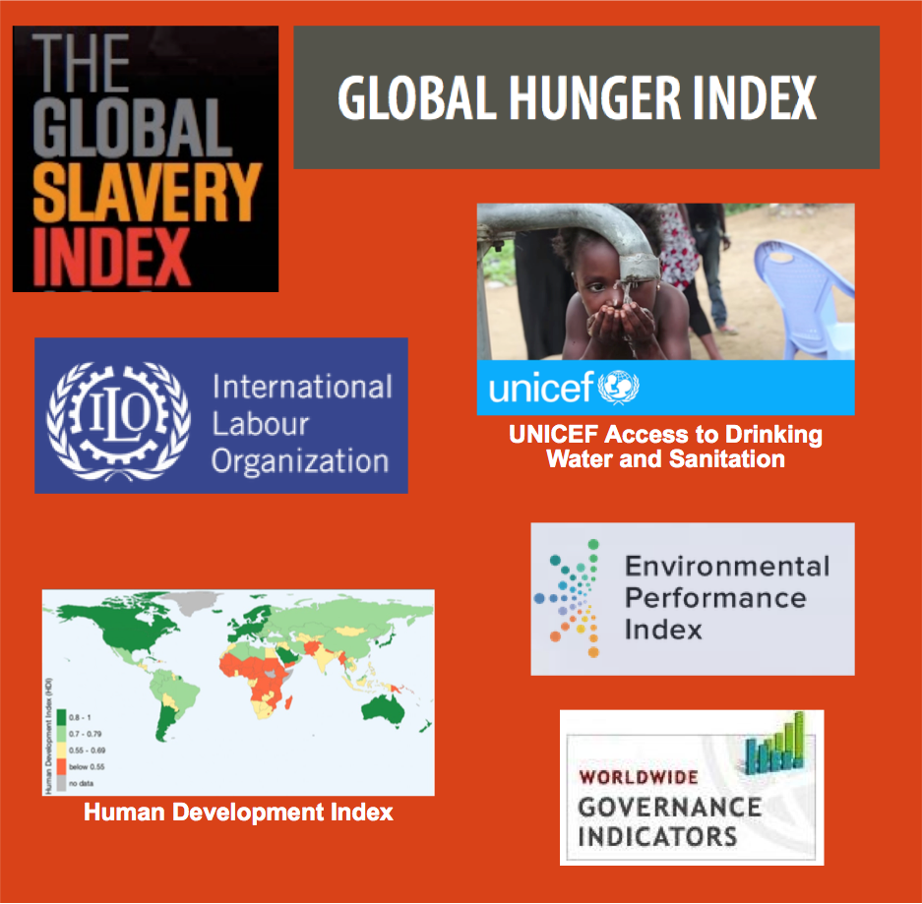

ISCC uses innovative tools to conduct risk assessments and to verify land use change
Example
Guatemala
Biodiversity Areas
Deforestation
High Carbon Stock
Social Indices
Deforestation in 2015
Forest
The GRAS Tool contains a heat map for potential deforestation. The EVI time series helps to confirm the conversion of forest to other land uses, e.g. cropland or pasture
With GRAS sustainability can be checked from your desktop

Slide 14
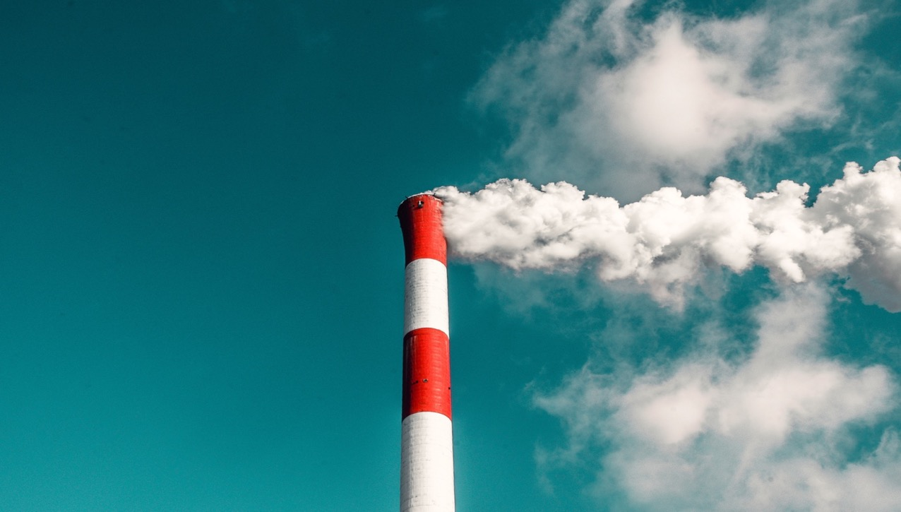
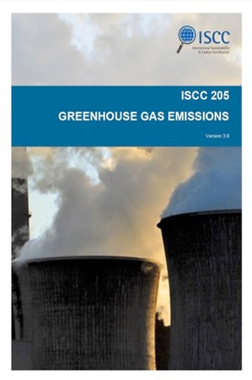



ISCC offers wide expertise in GHG calculation and supports companies in reducing their carbon footprint
To address climate change, countries adopted the Paris Agreement to limit global temperature rise to well below 2 degrees Celsius
„We want to reduce the carbon footprint of our production by 75 percent by 2030.”
Carbon Footprint
„Reduce the carbon footprint of "the drink in your hand” by 25 percent by 2020 against a 2010 baseline.”
Time

Slide 15
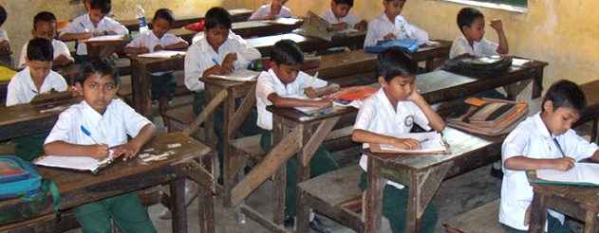
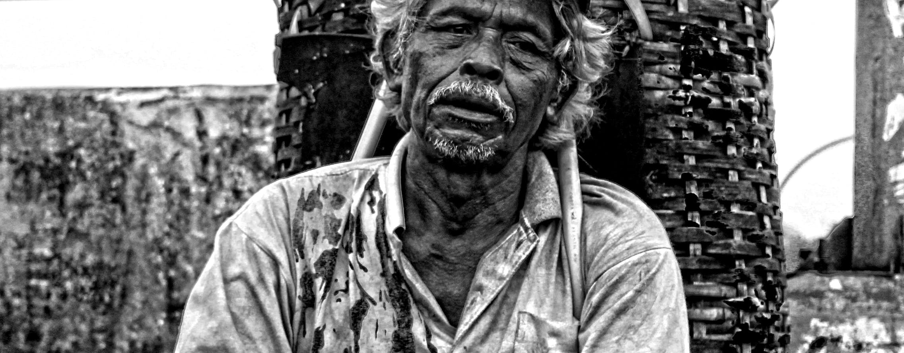
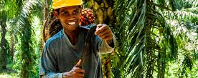

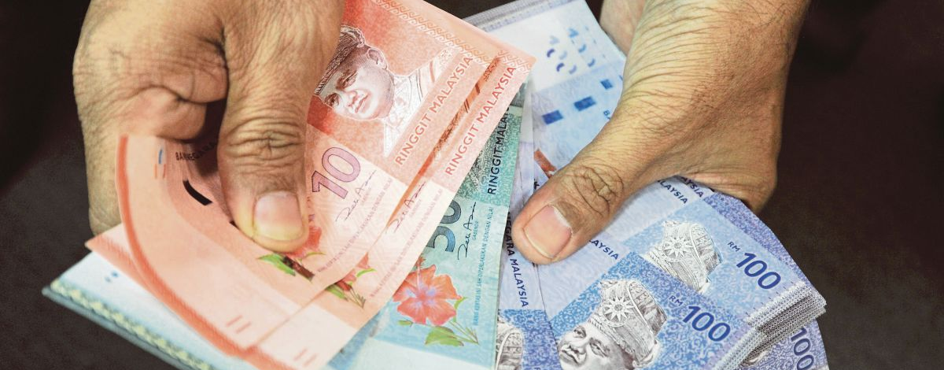
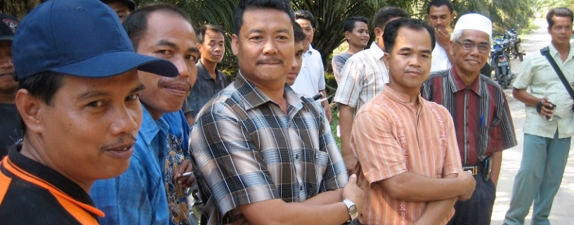
Social criteria are very important within ISCC –
Principle 4: No violation of human, labour and land rights
Access to primary school education
No forced labour & no discrimination
Only competent and non-vulnerable workers do hazardous work
Adquate training
Payment of a minimum wage
Labour organisation and collective bargaining are allowed

Slide 16
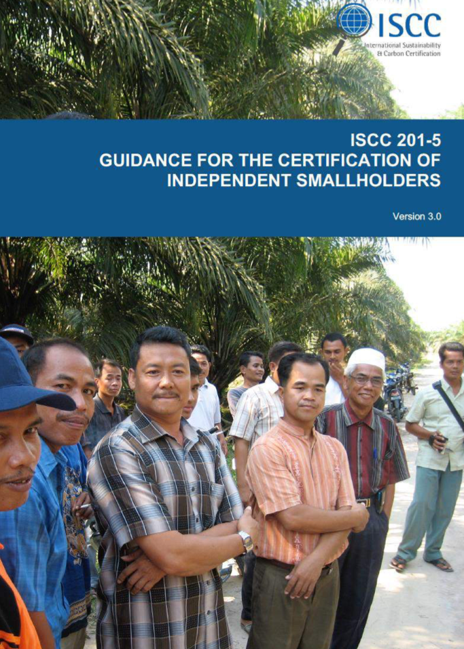
The ISCC Smallholder Program reduces the burden, risks and costs for smallholders
The majority of the world’s farms are managed by independent smallholders who often don‘t have access to certification
The ISH Program offers:
  Facilitated registration process for smallholders
  Simplified audit procedures
  Group certification under a central office
  Transfer of several responsibilities from ISH to a CO
  Compliance with ISCC principle 1 verified via GRAS
  Innovative train-the-trainer approach
  Dashboard and mobile apps to support ISH mapping, basic farmer data and field specific data collection, traceability

Slide 17
Palm is determined as a high iLUC-risk feedstock by the European Commission
The Delegated act on low and high iLUC-risk biofuels was published by the European Commission on 13 March 2019*
High iLUC-risk biofuels “for which significant expansion of the production into land with high-carbon stock is observed and the gradual decrease in their contribution to the targets laid down in this Directive” to be reduced starting from 31 December 2023 to 0% by 2030
Delegated act sets out criteria and methodology to determine high iLUC-risk feedstocks
Palm as only crop to be categorized as high iLUC-risk feedstock (in the annex to the delegated act)
*COMMISSION DELEGATED REGULATION (EU) 2019/807:
https://eur-lex.europa.eu/legal-content/EN/TXT/PDF/?uri=CELEX:32019R0807&from=EN

Slide 18
In case palm fulfils one of the three additionality measures, the feedstock may qualify as low iLUC risk
Additionality Measure 1: Unused and abandoned land
  Cultivation on abandoned land or severely degraded land
Additionality Measure 2: Yield increase
  Yield increase from agriculture can be achieved via implementing improved agricultural practices
Additionality Measure 3: Smallholders
  Measure applied by smallholders
Further clarification on the verification/ certification from the EU Commission currently missing

Slide 19

ISCC is actively involved in the current iLUC debate
An EU project on testing low iLUC risk verification via certification schemes on behalf of EU Commission will start soon
It must be emphasized that the phasing out will only start in 2023 and a complete ban will be implemented in 2030 – there is still time!
ISCC welcomes any kind of stakeholder involvement and supports an active dialogue with companies affected
→ ISCC will take findings from project into account for developing it’s low iLUC risk certification approach

Slide 20
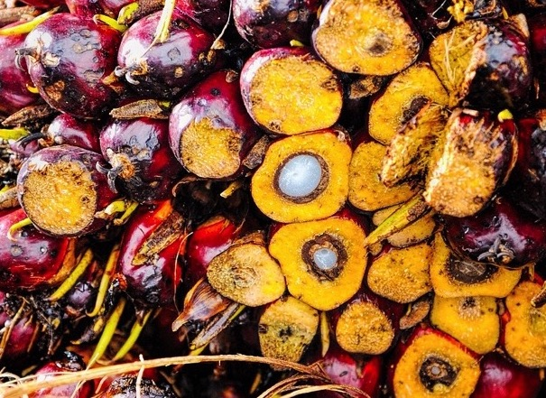
Conclusions
ISCC is a globally leading certification system for fully traceable and deforestation-free supply chains
Regulators, leading brand owners and retailers recognize ISCC
ISCC has comprehensive experience in carbon footprint calculations
The ISCC Independent Smallholder Program reduces barriers keeping small farmers from becoming certified
ISCC works on developing solutions for the certification of palm-based low-ILUC biofuels
Certified companies can benefit from price premiums and market access

Slide 21
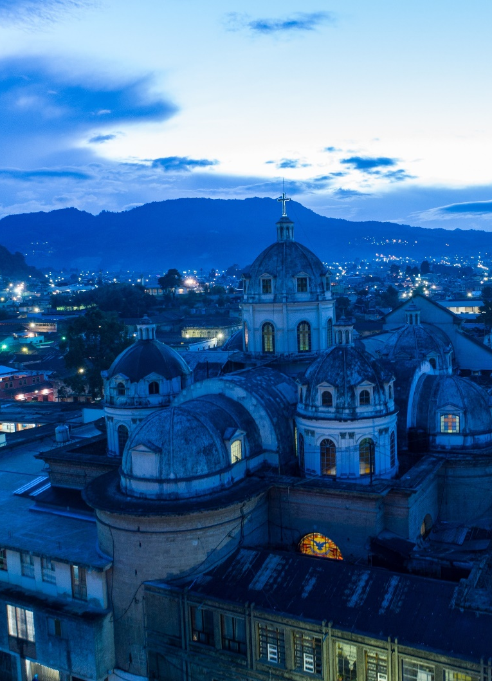
Upcoming events and trainings
The next Regional Committee Meeting Latin America will take place in Guatemala:
  21 January 2020, Guatemala
Regional Committee Meeting North America:
  19 November 2019, Las Vegas, USA
10th Global Sustainability Conference:
  12 February 2020, Brussels, Belgium
ISCC EU and PLUS Basic Training:
  05 – 07 November 2019, Cologne, Germany
  20 – 22 November 2019, Las Vegas, USA
  03 – 05 December 2019, Jakarta, Indonesia
All upcoming Trainings and Events are announced here: https://www.iscc-system.org/trainings-events/trainings/

Slide 22
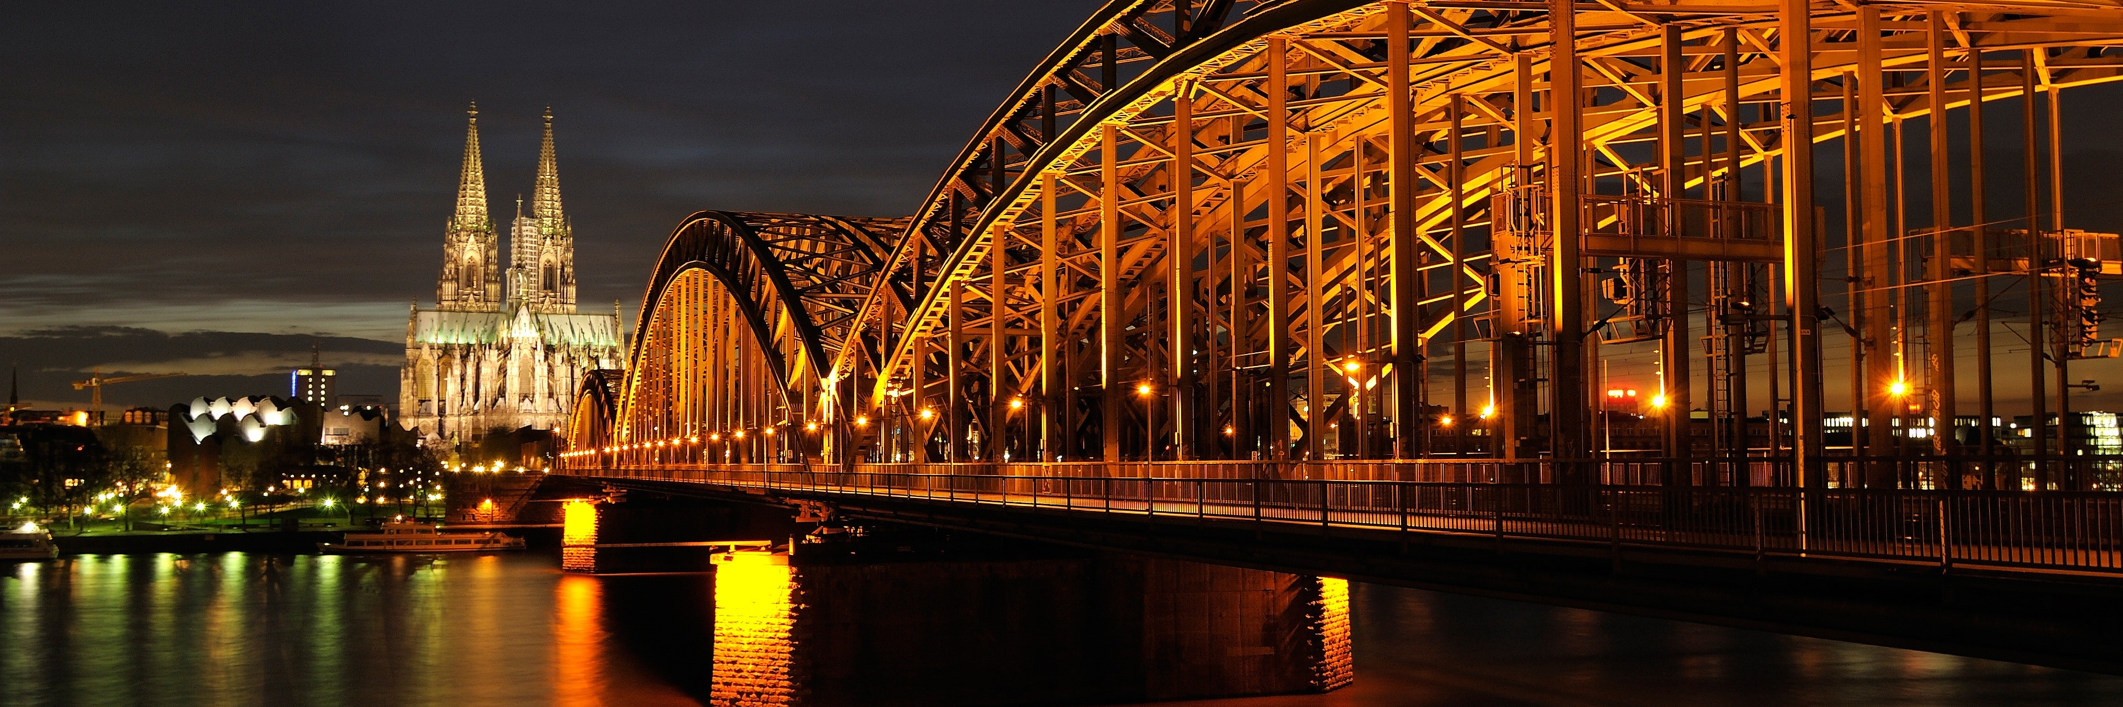
Muchas Gracias por su atención!
Many Thanks for your attention!
Dr Norbert Schmitz, ISCC System GmbH
Hohenzollernring 72, 50672 Cologne, Germany
Email: schmitz@iscc-system.org
www.iscc-system.org

